Slide 1
Team 82 – Community82 End of Sprint 3 Peer Review Demonstration
Team Members:
Tess Nash, Kris Kingston, Peipei Zhang, Ji Young Choi, Se Jun Ahn, Kent Lie and Sahib Onkar Singh
Website Link:
http://54.206.25.253/pages/index.php

Slide 2
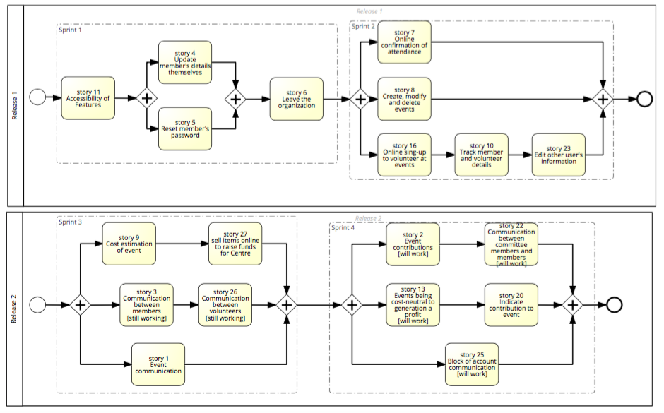
Procedure of All Sprints – BPMN Model

Slide 3
Sprint 3 – Expected Progress
What we wanted to achieve at the conclusion of Sprint 3:
Finish off the completion of overflow of stories from Release 1
Has 2 Stories that were an overflow from the previous Release that needed to be completed before we could move on to Sprint 3 Stories
Sprint 3 – 29 Story Points:
Had 5 Stories that we wanted to have completed at the end of the Sprint
Aimed to have all of these stories completed so we could move onto the next sprint

Slide 4
Sprint 3 – Actual Progress
What we actually achieved at the conclusion of Sprint 3:
Finished off the completion of overflow of stories from Release 1
Finalised the 2 Stories that were an overflow from the previous Release (only had minor issues with the tasks that needed to be finalised)
Sprint 3 – 29 Story Points:
Completed 3 out of 5 Stories that we wanted to have completed at the end of the Sprint
Some tasks still need to be finalised in order for them to be classified as 100% complete (minor errors with certain tasks – 85-90% completion rate thus far)

Slide 5
Sprint 3 – Ideal Task Progression
User Story ID and Description | Story Points | No. of Tasks Involved | Estimated Time Taken (Hours)
S01: Event Communication | 1 | 3 | 3
S03: Communication Between Members | 4 | 4 | 5
S09: Cost Estimation of Event | 4 | 4 | 9
S26: Communication Between Volunteers | 4 | 3 | 9
S27: Selling Items Online to Raise Funds for Centre | 16 | 4 | 17

Slide 6
Sprint 3 – Actual Task Progression
User Story ID and Description | Story Points | No. of Tasks Involved | ActualTime Taken (Hours)
S01: Event Communication | 1 | 3 | 4 (so far)
S03: Communication Between Members | 4 | 4 | 7 (so far)
S09: Cost Estimation of Event | 4 | 4 | 12
S26: Communication Between Volunteers | 4 | 3 | 10
S27: Selling Items Online to Raise Funds for Centre | 16 | 4 | 17
NOTE: Some tasks are experiencing some errors with execution, however we can still class these tasks as being completed with a 85% completion rate for stories; the stories highlighted are yet to be completed, with only 1 or 2 tasks needing to be finalised in order for them to be classified as complete

Slide 7
Sprint 3 Burndown Chart

Slide 8
Goals for the Next Sprint – Sprint 4:
Aim to finalise any incomplete user stories from Sprint 3 (Story ID 1 and Story ID 3)
This will be our top priority to ensure that these stories are complete before starting on Sprint 4
Once these tasks have been finalised, we will start on completing stories from Sprint 4
Continue progression on Acceptance Testing reports
Continue progression on User Testing to gain feedback from potential users

